Slide 1
Craft Beers and Breweries Study For Budweiser
Consultants:
Troy McSimov, Katon Pang

Slide 2
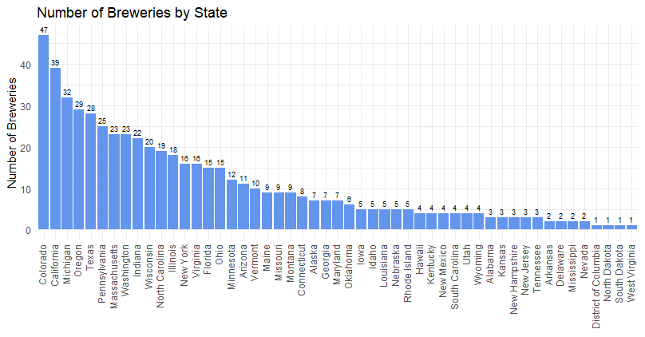
Budweiser Case Study
Budweiser provided our team with a couple data sets and asked us to conduct a study on US craft beers and their breweries.
Breweries.csv (558)
- ID (Primary Key)
- Name
- City
- State
Beers.csv (2,410)
- Name
- Beer ID (Primary Key)
- ABV
- IBU
- Brewery ID (Foreign Key)
- Style
- Ounces
In the following slides we will describe the approach to the analysis and the findings.

Slide 3
Addressing Missing Values
Original data:
ABV missing: 62 out of 2410 = 2.6%
IBU missing: 1005 out of 2410 = 42%
Style missing: 5
Address missing values with research:
ABV missing: 15 out of 2410 = 0.6%
IBU missing: 944 out of 2410 = 39%
Style missing: 3
After impute IBU missing values:
IBU missing: 11 out of 2410 = 0.46%
Impute missing IBU values with the median of IBU for that style of beer
Avg StdDev of IBU by Style 9.7
Avg StdDev of IBU by State 25.8

Slide 4
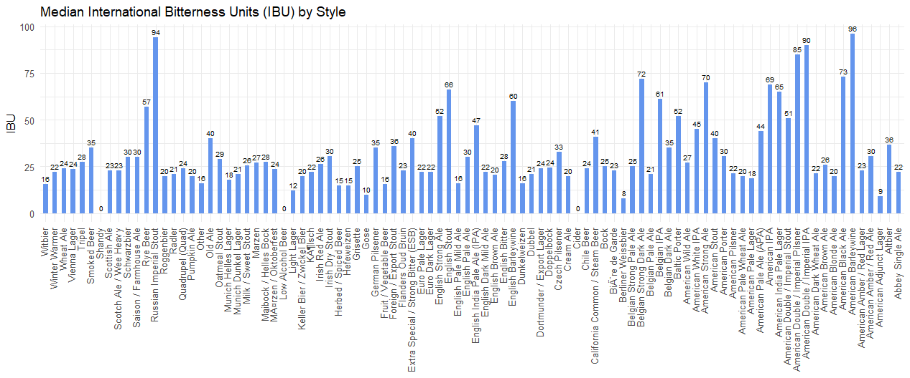
Median IBU by Style

Slide 5
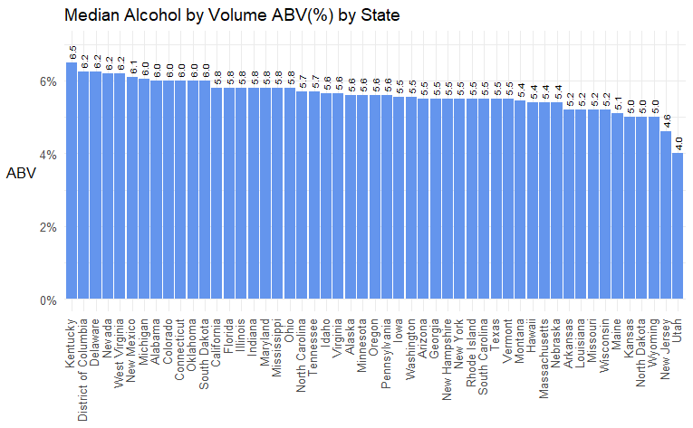
Median ABV by State
Median 5.6%
Top 5 States:
Kentucky
District of Columbia* (not a State)
Delaware
Nevada
West Virginia
Bottom 5 States:
Kansas
North Dakota
Wyoming
New Jersey
Utah
Notes:
Let’s take a look at median ABV by state. This bar graph shows median ABV in percentage for each state in a descending order.
The top 5 states that have the highest median alcohol content are:
The bottom 5 states that produce the least alcohol content are:

Slide 6
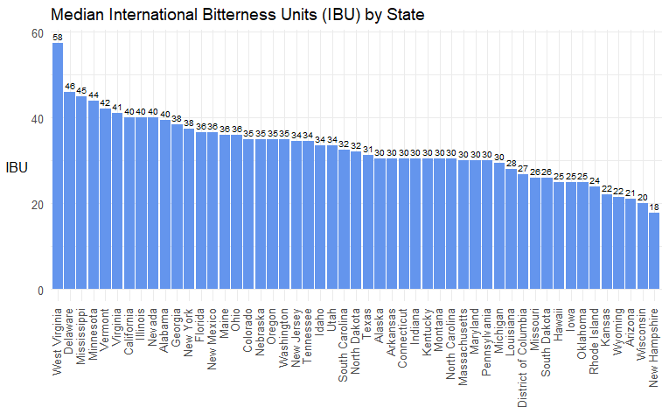
Median IBU by State
Median 30.5
Top 5 States:
West Virginia
Delaware
Mississippi
Minnesota
Vermont
Bottom 5 States:
Kansas
Wyoming
Arizonia
Wisconsin
New Hampshire
Notes:
This bar graph shows median IBU values for each state in a descending order.
The top 5 states had the highest median IBU are:
The bottom 5 states had the least median IBU are:

Slide 7
Comparing ABV and IBU by State
Kentucky led the States in highest average % alcohol, while West Virginia led the States in bitterness.
Kentucky stood out as being the only State in the Top 5 in ABV and unlike the other 4 was in the lower half for IBU.
Delaware and West Virginia were in Top 5 for both ABV and IBU.
Interesting finding!
Notes:
Kentucky led the States in the highest median alcohol content, while West Virginia led in bitterness.
It is interesting to note that while Kentucky and DC were in the top 5 in median alcohol content, they are at the lower half for their median IBU’s. While hops are often used to offset the taste for beers with a higher alcohol content, this doesn’t appear to be the case for them.
On the other hand, Delaware and West Virginia were both in the top 5 for ABV and IBU, suggesting the tendency of higher alcohol content beer have higher IBU value.

Slide 8
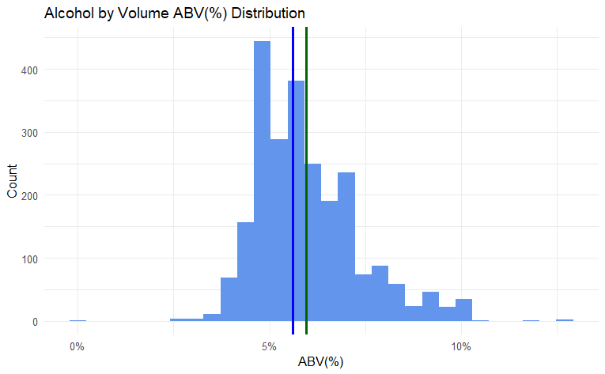
ABV Statistics
Min = 0.1%
1st Quartile (25%) = 5.0%
Median = 5.6%
Mean = 6.0%
3rd Quartile (75%) = 6.7%
Max = 12.8%
Standard Deviation = 1.4%
Budweiser: 5.0%
Max. Alcohol content:
Lee Hill Series Vol. 5
Boulder, CO
ABV 12.8%
Median
Mean
Notes:
This is the ABV distribution of craft beers in the data set.
The median alcohol content is at 5.6% and the mean at around 6%, while Budweiser falls in the first quantile at 5%.
CO had the most alcohol content beer in the data set, with 12.8% ABV.

Slide 9
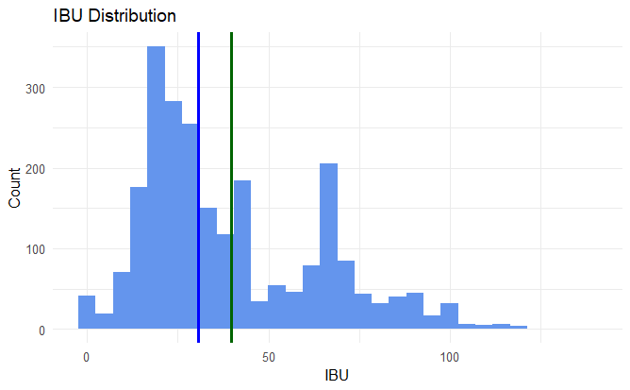
IBU Statistics
Min = 0
1st Quartile (25%) = 20.0
Median = 30.5
Mean = 39.7
3rd Quartile (75%) = 60.0
Max = 138.0
Standard Deviation = 24.5
Budweiser: 12
Highest IBU:
Bitter Bitch Imperial IPA
Astoria, OR
IBU 138
Median
Mean
Notes:
Here’s the IBU distribution of craft beers in the data set.
It has the median IBU at 30.5 and the mean at around 40, while Budweiser's IBU is 12.
OR had the bitterest beer in the data set, with an IBU of 138.
Let’s have Troy comes back for the rest of this presentation.

Slide 10
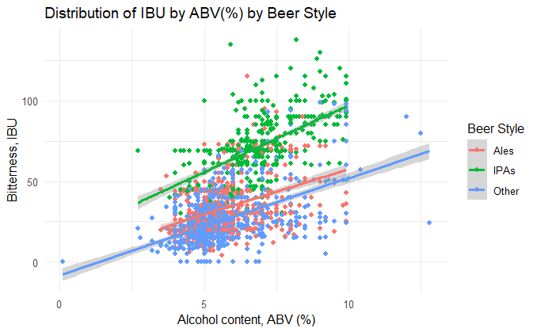
IBU vs. ABV by Beer Style
The scatter plot below shows that each classification of beer style showed similar positive correlation of bitterness rating to % of alcohol content.
Notes:
Often microbrewery

Slide 11
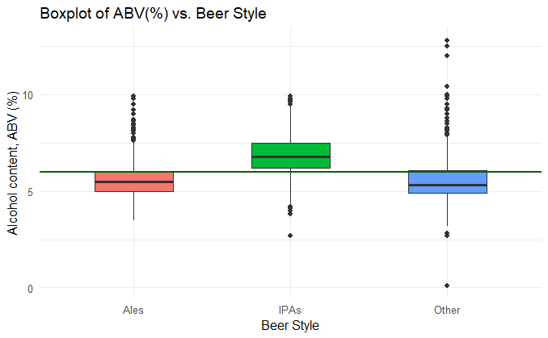
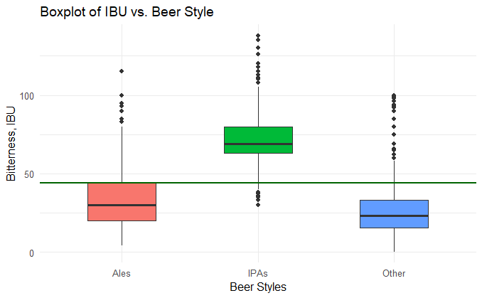
IPAs vs Ales
The boxplots below shows how IPA beers stand out amongst the remaining beers studied. IPA beers tend to have a higher % of alcohol content and a higher bitterness rating.
Notes:
Often microbrewery

Slide 12
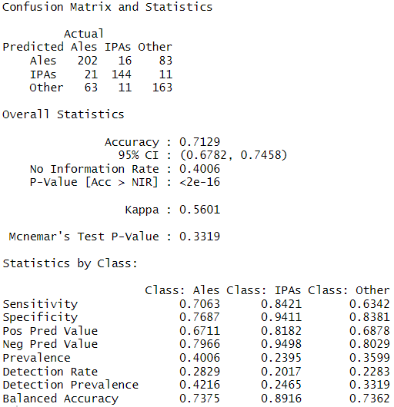
IPAs vs Ales
Data shows that one is more likely identify an IPA correctly over other classifications in this study
Notes:
Often microbrewery

Slide 13

Summary
Hoppier = Happier
Stouts, porters, barrel-aged beer takes time, the costs are higher with a more limited audience compared to IPA's, and consumes brewery/brewers resources more so than IPA's. The latter sells better and moves at higher velocity www.beeradvocate.com/community/threads/why-so-many-ipas.645499/
The data shows that IPAs stand out among other classifications of beers in this study and show a strong presence across the microbreweries in this case study.
The data also shows that there might be opportunities in certain geographic areas like Kentucky to introduce IPAs and other “hoppier” beers.
With the shortage of quality hops at an affordable price, investing in hops farming in Kentucky may create opportunities for higher quality product at a reasonable price to local breweries in that area.
Notes:
Often microbrewery

Slide 14
Thank you!

